Slide 1

COMS W4111 - Introduction to Databases
DBMS Architecture and Implementation: Query Processing, Transactions, Recovery
Donald F. Ferguson (dff@cs.columbia.edu)
Lecture 9: Query Processing, Transactions, Recovery

Slide 2

Contents
2 | Introduction to Databases (F18): Lecture 8: Disks, I/O, Indexes

Slide 3
Contents
Mid-semester course evaluations and actions.
Module II Topics Reminder
Query Processing (First Pass)
(Transactions) – If time
HW3 chalk talk and discussion

Slide 4
Module II – DBMS Architecture and Implementation
Reminder
4 | Introduction to Databases (F18): Lecture 8: Disks, I/O, Indexes

Slide 5
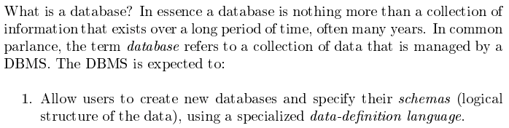
Database Management System Reminder
Covered for the relational model.
Database Systems: The Complete Book (2nd Edition) by Hector Garcia-Molina (Author), Jeffrey D. Ullman (Author), Jennifer Widom (Author)
5 | Introduction to Databases (F18): Lecture 10: Query Processing, Transactions, Recovert © Donald F. Ferguson, 2018

Slide 6
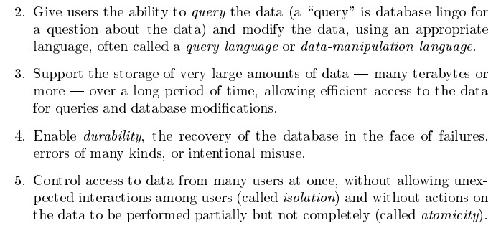
Database Management System Reminder
Focus for next part of course.
Database Systems: The Complete Book (2nd Edition) by Hector Garcia-Molina (Author), Jeffrey D. Ullman (Author), Jennifer Widom (Author)
6 | Introduction to Databases (F18): Lecture 10: Query Processing, Transactions, Recovert © Donald F. Ferguson, 2018

Slide 7

Data Management
Find things quickly.
Control access.
Durability
Database Systems: The Complete Book (2nd Edition) by Hector Garcia-Molina (Author), Jeffrey D. Ullman (Author), Jennifer Widom (Author)

Slide 8
Query Processing
8 | Introduction to Databases (F18): Lecture 10 Query Processing. Transactions, Recovery

Slide 9

Overview
9 | Introduction to Databases (F18): Lecture 10 Query Processing. Transactions, Recovery

Slide 10
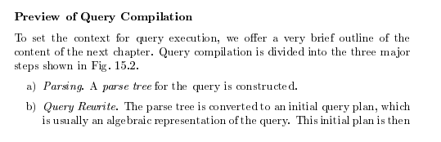
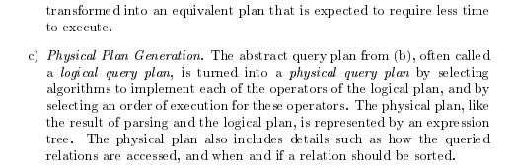
Query Compilation
Database Systems: The Complete Book (2nd Edition) 2nd Edition
by Hector Garcia-Molina (Author), Jeffrey D. Ullman (Author), Jennifer Widom (Author)

Slide 11
Parsing and Execution
Parser/Translator
Verifies syntax correctness and generates a parse tree.
Converts to logical plan tree that defines how to execute the query.
Tree nodes are operator(tables, parameters)
Edges are the flow of data “up the tree” from node to node.
Optimizer
Modifies the logical plan to define an improved execution.
Query rewrite/transformation.
Determines how to choose among multiple implementations of operators.
Engine
Executes the plan
May modify the plan to optimize execution, e.g. using indexes.

Slide 12
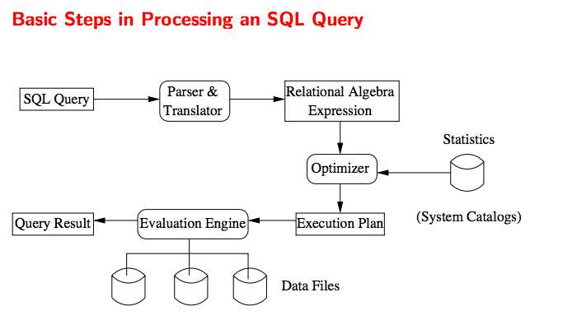
Query Processing Overview

Slide 13
Parsing
13 | Introduction to Databases (F18): Lecture 10 Query Processing. Transactions, Recovery

Slide 14
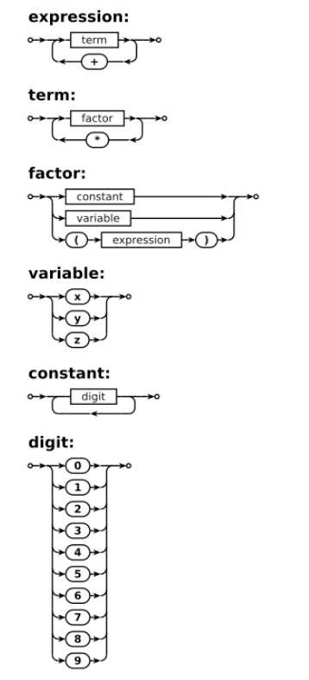
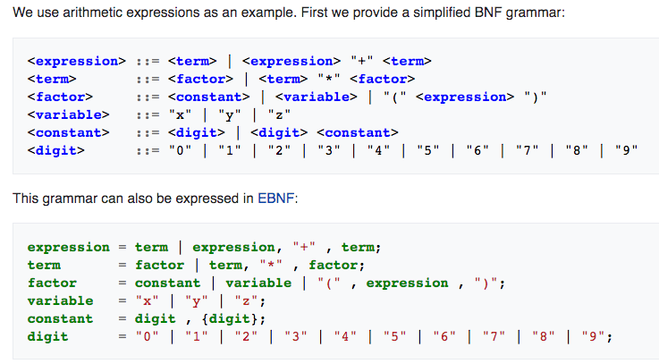
Grammar/Syntax Diagrams

Slide 15
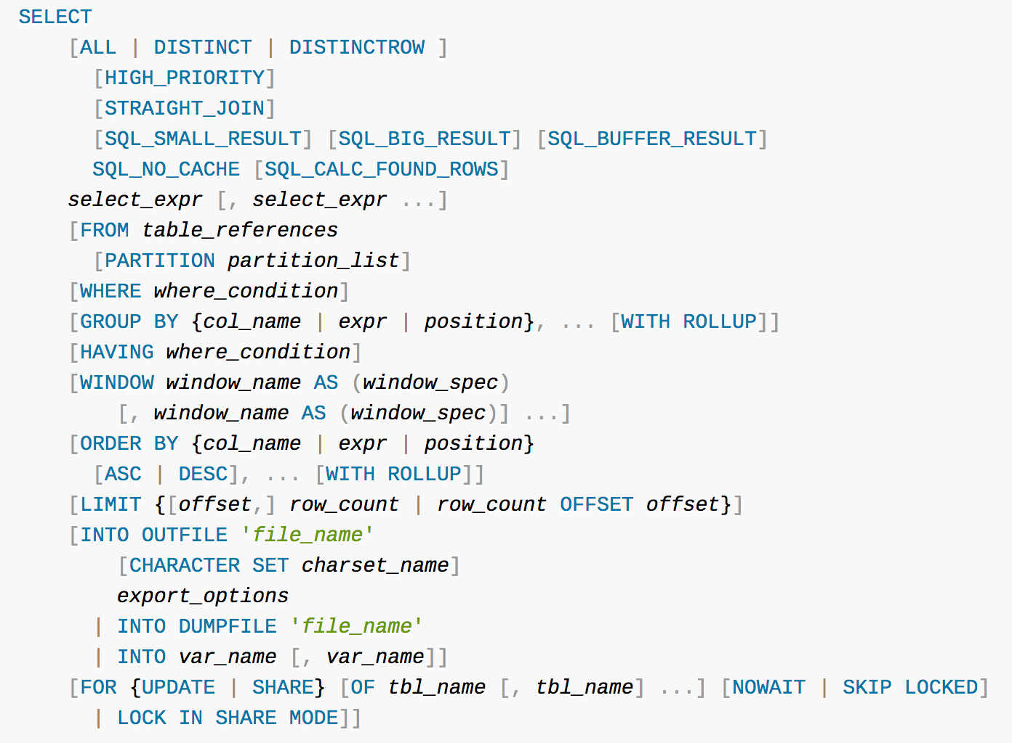
Parser
Grammar rules define valid SQL statements.
Query parser
Validates syntax.
Produces a logical parse tree/plan.
The optimizer and execution engine execute the plan.
Similar to any programming language

Slide 16
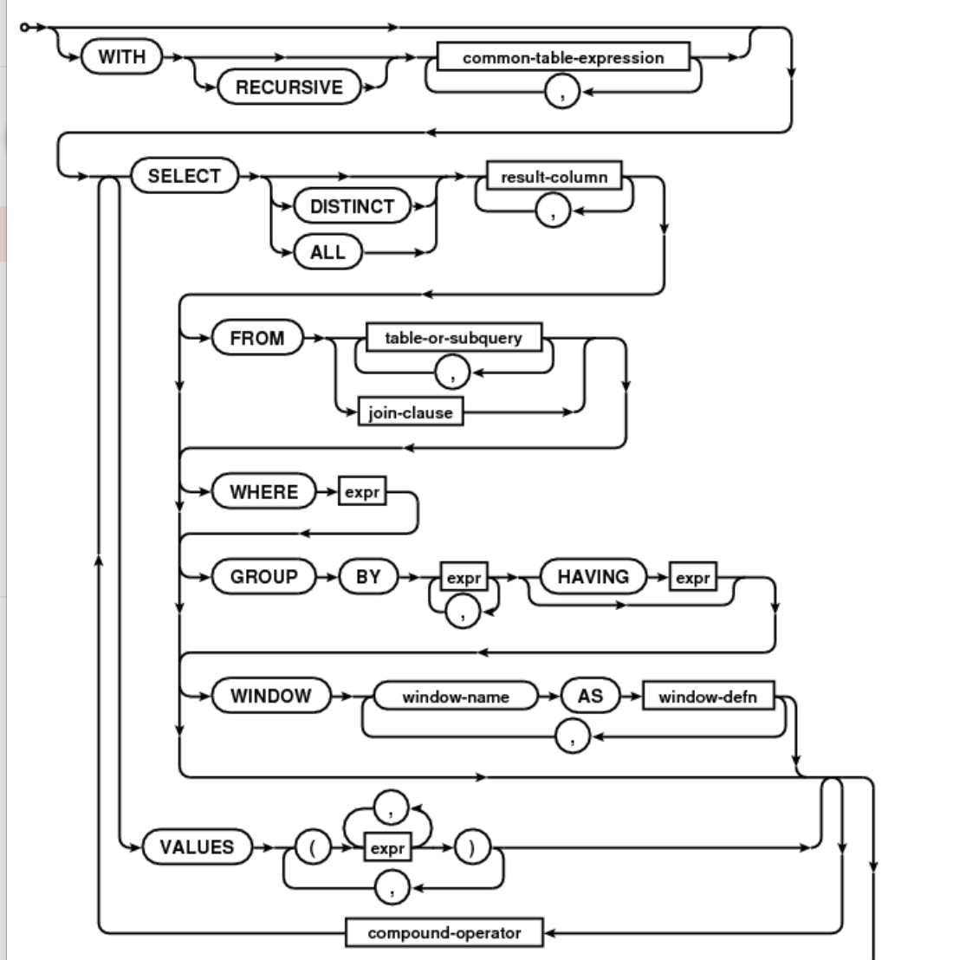
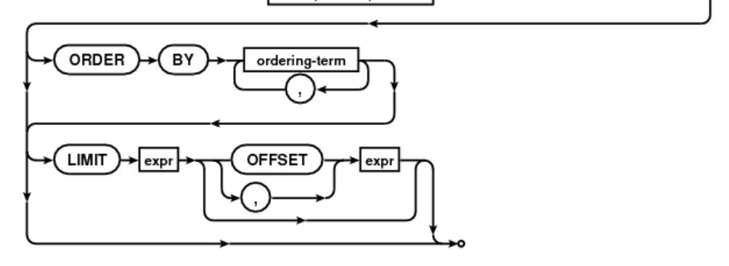
Parser
Formal definition of the SQL Language
Grammar rules.
Parse diagrams/machines.
You will learn about these concepts if you take:
COMS W3261: Computer Science Theory.
COMS W4115: Programming Languages and Translators.
Parser/Translator:
Validates the syntax is correct.
Validates that the symbols are correct, e.g. the table exists.
Converts the statement into an intermediate form that can be compiled or interpreted, just like any other computer language.

Slide 17
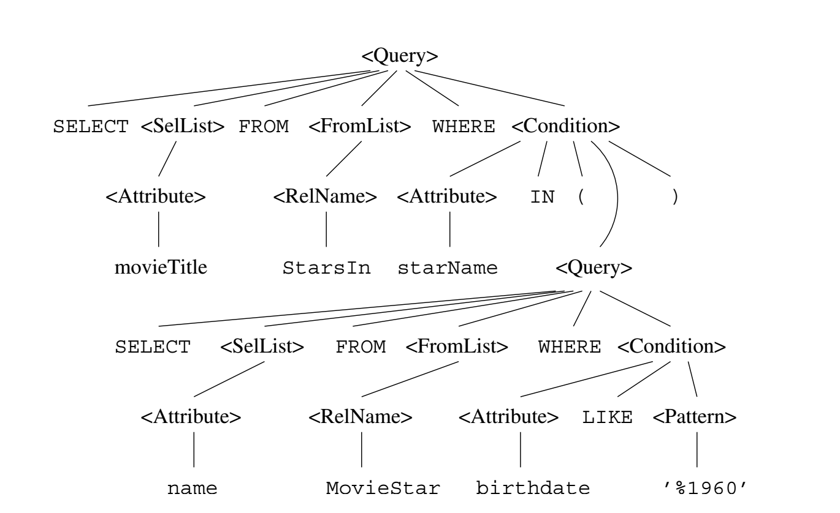
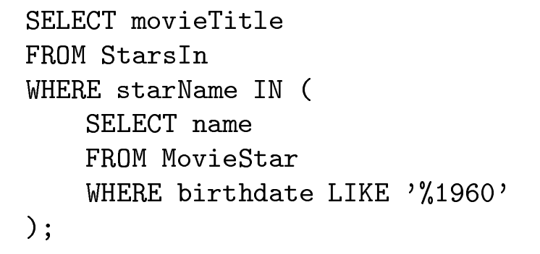
SQL Parse Tree

Slide 18
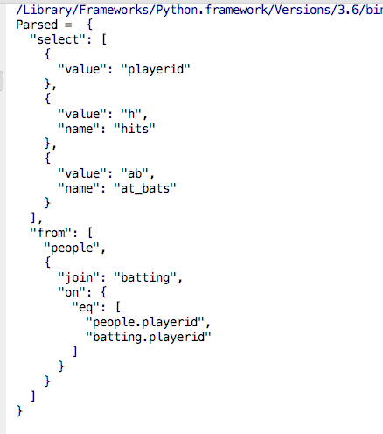
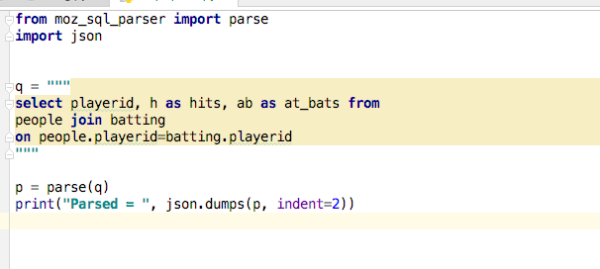
Simple Parsing Example
https://github.com/mozilla/moz-sql-parser
Lecture: Skim code at https://github.com/mozilla/moz-sql-parser

Slide 19
Python While Loop Syntax Tree

Slide 20
Common Concept – Example, Sentence Diagram
This is how we learned grammar in parochial school.
Instead of error messages when wrong, we got our knuckles smacked.
I have very good grammar skills

Slide 21
Query Plan/Logical Plan
21 | Introduction to Databases (F18): Lecture 10 Query Processing. Transactions, Recovery

Slide 22
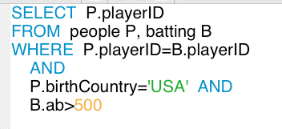
Simple Execution/Plan Tree
playerID
𝞂
ab> 500
birthCountry=‘USA’
The nodes are SQL operators. The operator parameters are:
Relations.
Parameters to operators.
The edges are the flow of data. The data flowing is a relation.
Base table.
Derived table.
playerID=playerID
people
batting

Slide 23
Relational Operations
We will consider how to implement:
Selection ( ) Selects a subset of rows from relation.
Projection ( ) Deletes unwanted columns from relation.
Join ( ) Allows us to combine two relations.
Set-difference ( ) Tuples in reln. 1, but not in reln. 2.
Union ( ) Tuples in reln. 1 and in reln. 2.
Aggregation (SUM, MIN, etc.) and GROUP BY
Since each op returns a relation, ops can be composed! After we cover the operations, we will discuss how to optimize queries formed by composing them.
Notes:
3

Slide 24
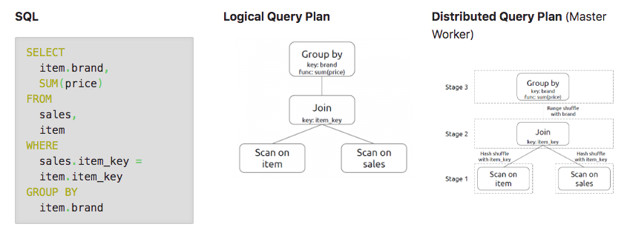
Logical Plan
https://gerardnico.com/data/type/relation/engine/query_plan
The plan executes in stages (bottom up).
Some stages can have parallelism, e.g. multiple threads to improve CPU utilization while processing I/O.

Slide 25
Homework 3 – Part IIa
def execute_join(self, left_r, right_r, on_fields, where_template, project_fields): """ Implements a JOIN on two CSV Tables. Support equi-join only on a list of common columns names. :param left_r: The left table, or first input table :param right_r: The right table, or second input table. :param on_fields: A list of common fields used for the equi-join. :param where_template: Select template to apply to the result to determine what to return. :param project_fields: List of fields to return from the result. :return: List of dictionary elements, each representing a row. """ pass
We have developed a basic CSVDataTable supporting find_by_template(), insert(), and delete().
We will add support for execute_join()

Slide 26
Optimization/Execution Overview
26 | Introduction to Databases (F18): Lecture 10 Query Processing. Transactions, Recovery

Slide 27
Overview of Query Evaluation
Plan: Tree of R.A. ops, with choice of alg for each op.
Each operator typically implemented using a `pull’ interface: when an operator is `pulled’ for the next output tuples, it `pulls’ on its inputs and computes them.
Two main issues in query optimization:
For a given query, what plans are considered?
Algorithm to search plan space for cheapest (estimated) plan.
How is the cost of a plan estimated?
Ideally: Want to find best plan. Practically: Avoid worst plans!
Notes:
2

Slide 28
Query Compilation
Database Systems: The Complete Book (2nd Edition) 2nd Edition
by Hector Garcia-Molina (Author), Jeffrey D. Ullman (Author), Jennifer Widom (Author)

Slide 29
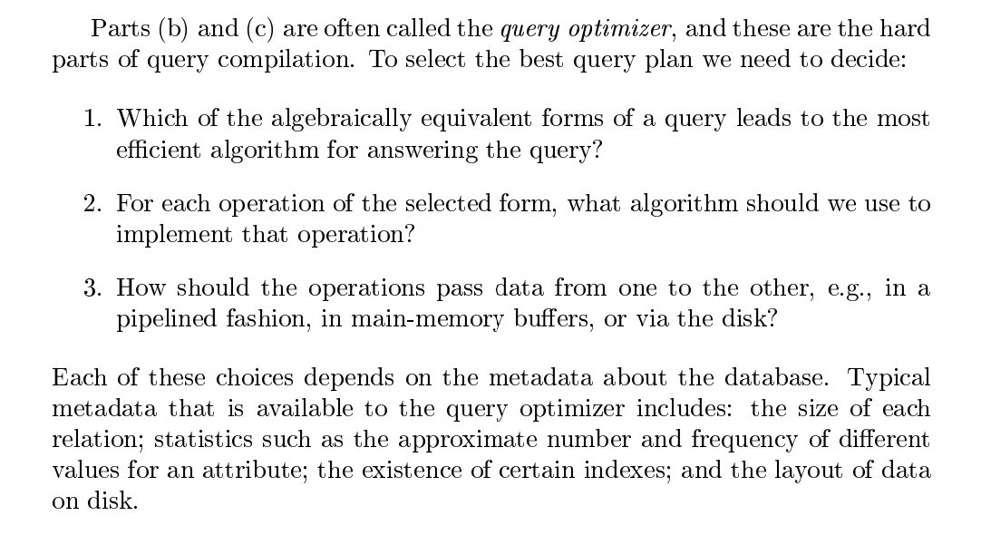
Query Optimization

Slide 30
Three Core Optimization Techniques
Query rewrite: Transform the logical query into an equivalent, more efficient query (lower cost query), e.g.
R ⋈ S is the same as S ⋈ R
𝞼(R ⋈ S) is the same at 𝞼(R) ⋈ 𝞼(S)
𝛅(R ⋈ S) = 𝛅(R) ⋈ 𝛅(S), where 𝛅 is the distinct operator.
Access path selection: Which index to choose?
Operator implementation selection:
There are several related implementations for each operator
For example,
Sort Scan
Sort Join
Hash Join
Hash Distinct

Slide 31
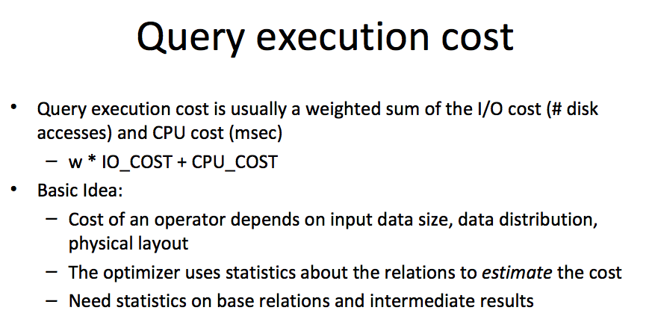
Query Execution Cost

Slide 32
Statistics and Catalogs
Need information about the relations and indexes involved. Catalogs typically contain at least:
# tuples (NTuples) and # pages (NPages) for each relation.
# distinct key values (NKeys) and NPages for each index.
Index height, low/high key values (Low/High) for each tree index.
Catalogs updated periodically.
Updating whenever data changes is too expensive; lots of approximation anyway, so slight inconsistency ok.
More detailed information (e.g., histograms of the values in some field) are sometimes stored.
Notes:
8

Slide 33
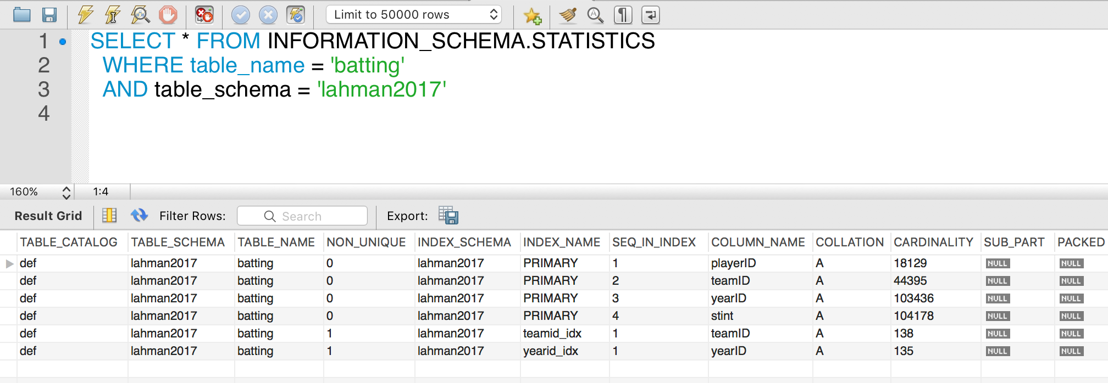
MySQL Example

Slide 34
The Catalog Contains
For each table
Table name, storage information.
Attribute name and type for each column.
Index name, type and indexed attributes
Constraints
Statistical information
Cardinality of each table
Size: No. of blocks.
Index cardinality: Number of distinct key values for each index
Index size: Number of blocks for each index.
Index tree height
Index ranges

Slide 35
Access Path
Every relational operator accepts one or more tables as input. The operators “accesses the tuples” in the tables.
There are two “ways” to retrieve the tuples
Scan the relation (via blocks)
Use an index and matching condition.
A selection condition is in conjuctive normal form if
Each term is column_name op value
op is one of <, <=, =, >, >=, <>
The terms are combined, e.g. (nameLast = ‘Ferguson’) AND (ab > 500)
CNF allows using a matching index for the access path.
The engine can select a matching index
A Hash Index on (c1,c2,c3) if the condition is c1=x AND c2=y AND c3=z.
A Tree Index if the condition is (can be ordered as)
c1 op value
c1 op x AND/OR c2 op y
… …
Many indexes may match, and the engine chooses the most selective match (number of tuples or blocks) that match.

Slide 36
Access Paths
An access path is a method of retrieving tuples:
File scan, or index that matches a selection (in the query)
A tree index matches (a conjunction of) terms that involve only attributes in a prefix of the search key.
E.g., Tree index on <a, b, c> matches the selection a=5 AND b=3, and a=5 AND b>6, but not b=3.
A hash index matches (a conjunction of) terms that has a term attribute = value for every attribute in the search key of the index.
E.g., Hash index on <a, b, c> matches a=5 AND b=3 AND c=5; but it does not match b=3, or a=5 AND b=3, or a>5 AND b=3 AND c=5.
Notes:
13

Slide 37
Query Rewrite
37 | Introduction to Databases (F18): Lecture 10 Query Processing. Transactions, Recovery

Slide 38
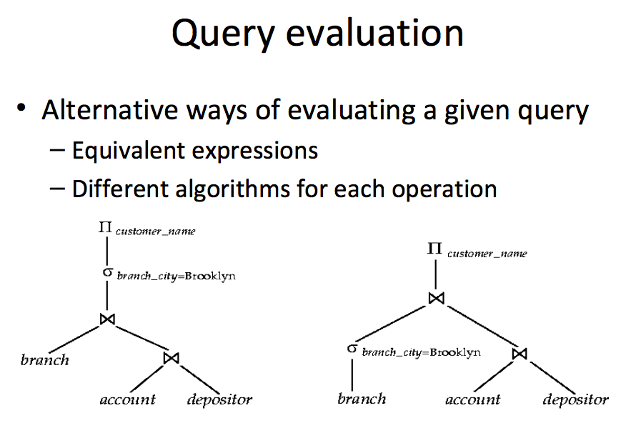
Many Ways to Evaluate a Query

Slide 39
Simple Technique – SELECTion Pushing
Consider two relations
StarsIn(title, year, star_name)
Movies(title, year, length, genre, studio_name, producer_no)
Find everyone who starred in a comedy movie in 1996
Query 1:
SELECT star_name, FROM StarsIn JOIN Movies ON StarsIn.title=Movies.title AND StarsIn.year=Movies.year WHERE StarsIn.year=1996 and Movies.genre=‘Comedy’
Query 2:
SELECT star_name FROM (SELECT star_name, title, year FROM StarsIn WHERE year=1996 as a) JOIN
(SELECT title, year, genre FROM Movies WHERE year=1996 AND genre=‘Comedy’) ON a.year=b.year and a.title=b.title
These queries are equivalent, but (2) is much more efficient.

Slide 40
Simple Technique – SELECTion Pushing
SELECT on a JOIN of table R and table S compares O(#(R)*#(S)) tuples
Have to load relevant blocks
Compare the tuples to compute the JOIN
Scan the JOIN to apply the SELECT
Pushing the SELECT(s) through the JOINs
May vastly reduce the size of the table to JOIN
Only JOIN tuples that could be selected in the WHERE clause.
You can also push project through JOIN, but this reduces the size of the data, not the number of tuples examined.
Consider two relations
StarsIn(title, year, star_name)
Movies(title, year, length, genre, studio_name, producer_no)
Find everyone who starred in a comedy movie in 1996
Query 1:
SELECT star_name, FROM StarsIn JOIN Movies ON StarsIn.title=Movies.title AND StarsIn.year=Movies.year WHERE StarsIn.year=1996 and Movies.genre=‘Comedy’
Query 2:
SELECT star_name FROM (SELECT star_name, title, year FROM StarsIn WHERE year=1996 as a) JOIN
(SELECT title, year, genre FROM Movies WHERE year=1996 AND genre=‘Comedy’) ON a.year=b.year and a.title=b.title
These queries are equivalent, but (2) is much more efficient.

Slide 41
A Note on Complex Selections
(day<8/9/94 AND rname=‘Paul’) OR bid=5 OR sid=3
Selection conditions are first converted to conjunctive normal form (CNF):
(day<8/9/94 OR bid=5 OR sid=3 ) AND (rname=‘Paul’ OR bid=5 OR sid=3)
We only discuss case with no ORs; see text if you are curious about the general case.
Notes:
13

Slide 42
One Approach to Selections
Find the most selective access path, retrieve tuples using it, and apply any remaining terms that don’t match the index:
Most selective access path: An index or file scan that we estimate will require the fewest page I/Os.
Terms that match this index reduce the number of tuples retrieved; other terms are used to discard some retrieved tuples, but do not affect number of tuples/pages fetched.
Consider day<8/9/94 AND bid=5 AND sid=3. A B+ tree index on day can be used; then, bid=5 and sid=3 must be checked for each retrieved tuple. Similarly, a hash index on <bid, sid> could be used; day<8/9/94 must then be checked.
Notes:
14

Slide 43
Using an Index for Selections
Cost depends on #qualifying tuples, and clustering.
Cost of finding qualifying data entries (typically small) plus cost of retrieving records (could be large w/o clustering).
In example, assuming uniform distribution of names, about 10% of tuples qualify (100 pages, 10000 tuples). With a clustered index, cost is little more than 100 I/Os; if unclustered, upto 10000 I/Os!
SELECT *
FROM Reserves R
WHERE R.rname < ‘C%’
Notes:
12

Slide 44
Projection
SELECT DISTINCT
R.sid, R.bid
FROM Reserves R
The expensive part is removing duplicates.
SQL systems don’t remove duplicates unless the keyword DISTINCT is specified in a query.
Sorting Approach: Sort on <sid, bid> and remove duplicates. (Can optimize this by dropping unwanted information while sorting.)
Hashing Approach: Hash on <sid, bid> to create partitions. Load partitions into memory one at a time, build in-memory hash structure, and eliminate duplicates.
If there is an index with both R.sid and R.bid in the search key, may be cheaper to sort data entries!
Notes:
16

Slide 45
Join: Index Nested Loops
foreach tuple r in R do
foreach tuple s in S where r_{i} == s_{j} do
add <r, s> to result
If there is an index on the join column of one relation (say S), can make it the inner and exploit the index.
Cost: M + ( (M*p_{R}) * cost of finding matching S tuples)
M=#pages of R, p_{R}=# R tuples per page
For each R tuple, cost of probing S index is about 1.2 for hash index, 2-4 for B+ tree. Cost of then finding S tuples (assuming Alt. (2) or (3) for data entries) depends on clustering.
Clustered index: 1 I/O (typical), unclustered: upto 1 I/O per matching S tuple.

Slide 46
Join: Sort-Merge (R S)
i=j
Sort R and S on the join column, then scan them to do a ``merge’’ (on join col.), and output result tuples.
Advance scan of R until current R-tuple >= current S tuple, then advance scan of S until current S-tuple >= current R tuple; do this until current R tuple = current S tuple.
At this point, all R tuples with same value in Ri (current R group) and all S tuples with same value in Sj (current S group) match; output <r, s> for all pairs of such tuples.
Then resume scanning R and S.
R is scanned once; each S group is scanned once per matching R tuple. (Multiple scans of an S group are likely to find needed pages in buffer.)
Notes:
11

Slide 47
Example of Sort-Merge Join
Cost: M log M + N log N + (M+N)
The cost of scanning, M+N, could be M*N (very unlikely!)
With 35, 100 or 300 buffer pages, both Reserves and Sailors can be sorted in 2 passes; total join cost: 7500.
Notes:
12

Slide 48
Homework 3 – Overview
48 | Introduction to Databases (F18): Lecture 8: Disks, I/O, Indexes

Slide 49
Homework 3 Overview
Expand on HW I – CSVDataTable
I will provide the base functions.
Placeholders for functions you will write.
You will develop
CSVCatalog: Holds information about tables
Columns
File name
Indexes
Extensions to CSVDataTable
Implement index definitions for search only.
Enforce basic integrity constraints using catalog information.
JOINs and join optimizations
Will provide a basic insight into some DBMS function implementation.
Will role out in two step: Catalog/integrity, Query optimization

